Slide 1
Advisory Systems in the Inner Circle
Management style of leaders: Shapes the role their advisory systems play
Three models
Formalistic: orderly, hierarchical (e.g., George W. Bush; Richard Nixon)
Competitive: open debate, less formal channels of advisers (e.g., Franklin Roosevelt or Obama)
Collegial: informal subgroups with openness and competition (e.g., Bill Clinton and Barack Obama)
Can we discern a particular type of management style in the Trump administration?
Notes:
Learning Objective Number: 4.3

Slide 2
Judicial Interventions in Foreign Policy
Courts generally see foreign affairs as political rather than legal issues
Political issues should be resolved in the political arena by Congress and the president
Tend to rule on issues of First Amendment rights
Tend to rule when domestic and international policy are intertwined
Notes:
Learning Objective Number: 4.4

Slide 3
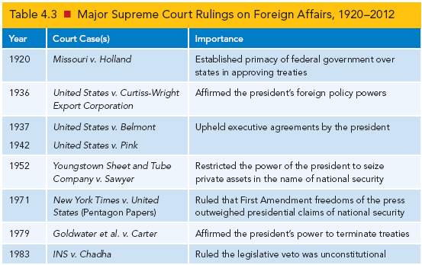
Judicial Interventions in Foreign Policy
Notes:
Learning Objective Number: 4.4

Slide 4
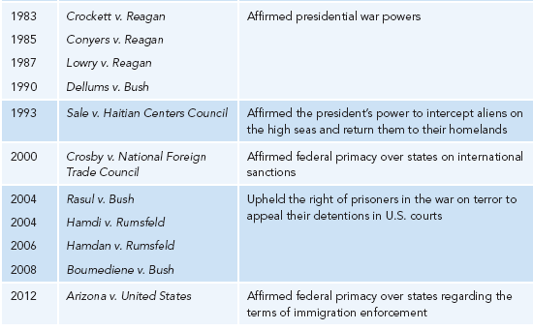
Judicial Interventions in Foreign Policy

Slide 5
Legal Quandaries in the War on Terror
Controversies in the war on terror
Declaration of global war on terror after 9/11
Not against nation-states, despite invasion of Iraq and Afghanistan
Difficulty tracking results because of civil wars and unrest
Conflict with detainees in Cuba
Scandal at Abu Ghraib prison in Iraq
Supreme Court forced to rule on conditions, treatment, legal questions
Congressional backlash
Notes:
Learning Objective Number: 4.4

Slide 6
Conclusion
The president remains the hub of foreign policy due to formal and informal powers as well as norms and historic patterns.
The constitutional “invitation to struggle” will remain a defining fixture of U.S. foreign policy making.
Personal aspects of presidential decision-making and character will also continue to affect policy outcomes.

Slide 7
Congress Beyond the “Water’s Edge”
Constitution: Separate institutions sharing power
Article I: Congress as the “first branch of government”
More explicit grants of authority
BUT, Congress has greater incentives for domestic activism than in foreign affairs. Why?
Congressional mood swings attributable to changes in party control
Importance of unified government: Greater deference to executive foreign policy agenda and activism

Slide 8
Congress Beyond the “Water’s Edge”
Congressional mechanisms of influence
War powers
Control of the budget and regulation of commerce
Advise and consent on many appointees
Why give Congress all of these powers?
Three characteristics of recent legislative sessions
Longevity of congressional members
Polarization and party unity—a disappearing center
Public discontent with legislative bodies

Slide 9
Trends in Legislative-Executive Relations
Cold War context produced broad cooperation between the White House and Capitol Hill
Vietnam War led Congress to become more assertive
Post–Cold War period marked by ongoing conflict between executive, legislative branches
No direct threat to United States from other great powers
More entrenched divides between major parties
More compliance after September 11, 2001
Patriotism and electoral factors
Unified government
Deference then opposition under Trump
Notes:
Learning Objective: 5.1

Slide 10
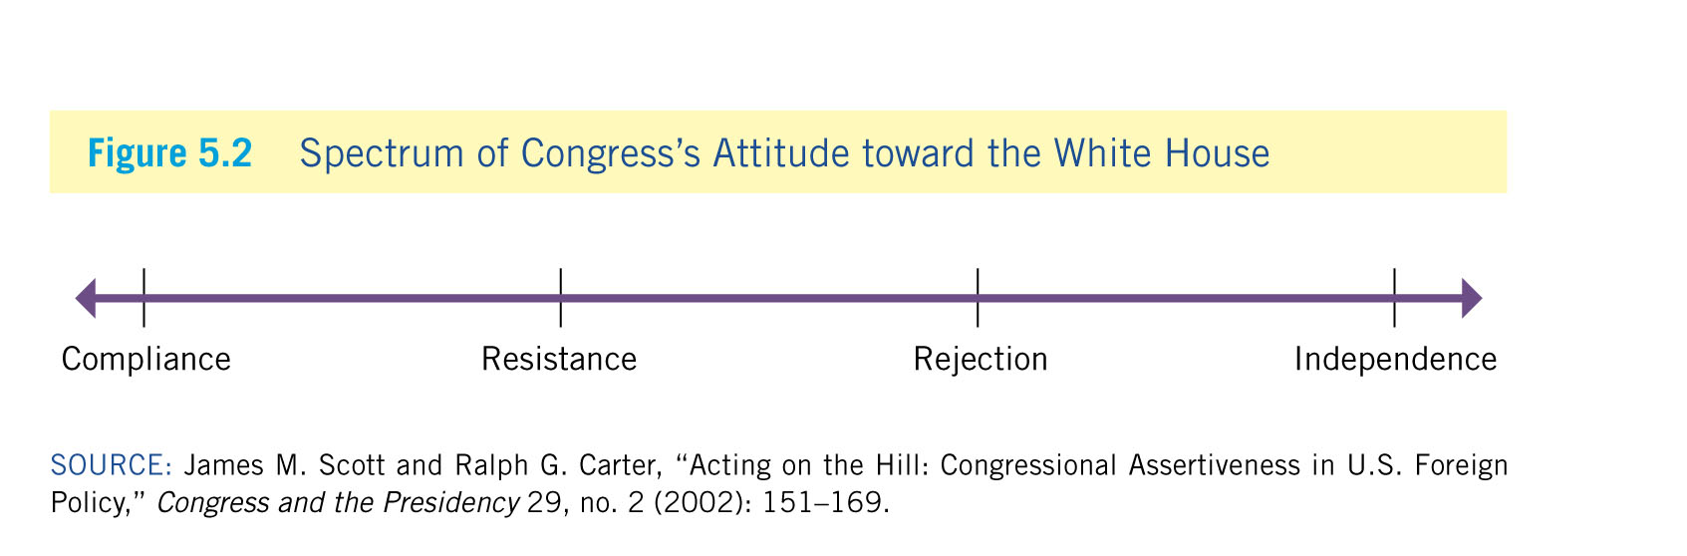
Trends in Legislative-Executive Relations
Notes:
Learning Objective: 5.1

Slide 11
Trends in Legislative-Executive Relations
The situational context of policy making is crucial to understanding fluctuations in legislative–executive relations
Two sets of factors: Nature of issues and timing of decisions
Congress more active in economic issues, issues tied to domestic issues (such as immigration)
President given more leeway at beginning of term (“honeymoon period”), Congress more likely to be active later
Presidents also given more freedom during crises
Congressional diplomacy plays critical role as well
Notes:
Learning Objective: 5.1
Can we think of a reason for why Congress tends to be more engaged when it comes to economic issues, or even immigration?

Slide 12
Collaboration and Discord in the Cold War
Post–World War II threat of Soviet Union: Truman’s containment doctrine
Congressional consensus in containing communism
National Security Act of 1947
Bretton Woods institutions
NATO
Limited troop deployments (South Korea)
Eisenhower’s expansion of military alliances, nuclear arsenal also supported by Congress
Congressional foreign policy role: “legitimizing of presidential decisions”
Benefits for congressional members in form of military contracts, new military bases, interstate highway system
Notes:
Learning Objective: 5.1

Slide 13
Collaboration and Discord in the Cold War
Domestic consensus continued under Kennedy
Johnson: Gulf of Tonkin Resolution (1964) gave carte blanche support for intervention in Vietnam
Nixon: Congress divided from president, mostly Democrats
Vietnam War unpopular, Watergate scandal
Structural reforms in Congress to promote oversight in foreign and domestic affairs
Less of a seniority system
More committees and subcommittees
Notes:
Learning Objective: 5.1

Slide 14
Collaboration and Discord in the Cold War
String of oversight legislation in foreign affairs in the 1970s
Case–Zablocki Act: Required president to report all international agreements to Congress within 60 days of the agreement’s entering into force
War Powers Resolution: Required president to report all military deployments to Congress and authorized Congress to order the troops home after 60 days
Nelson–Bingham Amendment: Required congressional review of arms sales of more than $25 million
Jackson–Vanik Amendment: Prevented granting most-favored nation trade status to countries that restrict emigration
Intelligence Oversight Act: Allowed House and Senate committees to oversee U.S. intelligence activities and required president to notify Congress of covert operations
Notes:
Learning Objective: 5.1

Slide 15
New Tensions in the New World Order
New global environment after end of the Cold War
George H. W. Bush’s “New World Order” causes more animosity with Congress
Intensified polarization of Congress
Generational shifts, different experiences of legislators
New Democrats abandoned Clinton; Republican majority elected in Congress (new isolationism)
Sen. Jesse Helms campaigned against international affairs budgets, agencies, ambassadors
Rejected Comprehensive Test Ban Treaty, which was popular worldwide; rejection of Kyoto protocol, ICC.
Notes:
Learning Objective: 5.1

Slide 16
Deference in the War on Terror
George W. Bush: Entered office with united government, no major foreign policy agenda
Terrorist attacks ended discord between executive and legislative branches for first years of war on terror
Authorization for the Use of Military Force of 2001 (AUMF) in Afghanistan
USA PATRIOT Act
Authorization for war in Iraq
Notes:
Learning Objective: 5.1

Slide 17
Congressional Pushback in the Obama Years
Dissent about intelligence gathering and military occupation in Iraq
2006 elections: Democrats regain majority status in both chambers
2008 presidential election: Brief period of united government
2010 elections: Republicans regain control of the House
Leads to more divided government and political gridlock
Reelection of President Obama
More pushback regarding foreign policy goals as members of Congress complain that president is “too passive” on important issues and challenges
Russia’s annexation of Ukraine
Iran’s nuclear ambitions
Lack of intervention in Syria
Notes:
Learning Objective: 5.1

Slide 18
Deference and Opposition in the Age of Trump
2016, Trump’s “America First” platform supported by some rejected by others.
Attracts support from House republicans
Some Senate republicans are more critical of President’s foreign policy orientation.
2018 Midterms
Democrats take back the House, Republicans expand lead in the Senate.
More pushback regarding Trump’s foreign policy goals as members of Congress reject administration’s border wall and emergency declaration.
Others critical of troop withdrawal in the Middle East
President’s remarks regarding authoritarian leaders around the world

